Slide 1

B.Sc.Engg. In (CsE)
Level 2 Semester IV Math-221
Credit: 3.00 Marks: 100
Fourier series
(Fourier integral, Examples)
Mehetaj parvine
Lecturer
Mathematics Department
Patuakhali Science and Technology University
Email: mehetajparvine@gmail.com
Cell: 01747792047
11-04-2021

Slide 2
Contents
Fourier series
Coefficient and half range Fourier series
Fourier Analysis
Fourier integral
Z-Transformation and its application
Laplace transforms
Application of Fourier series and Laplace Transform

Slide 3
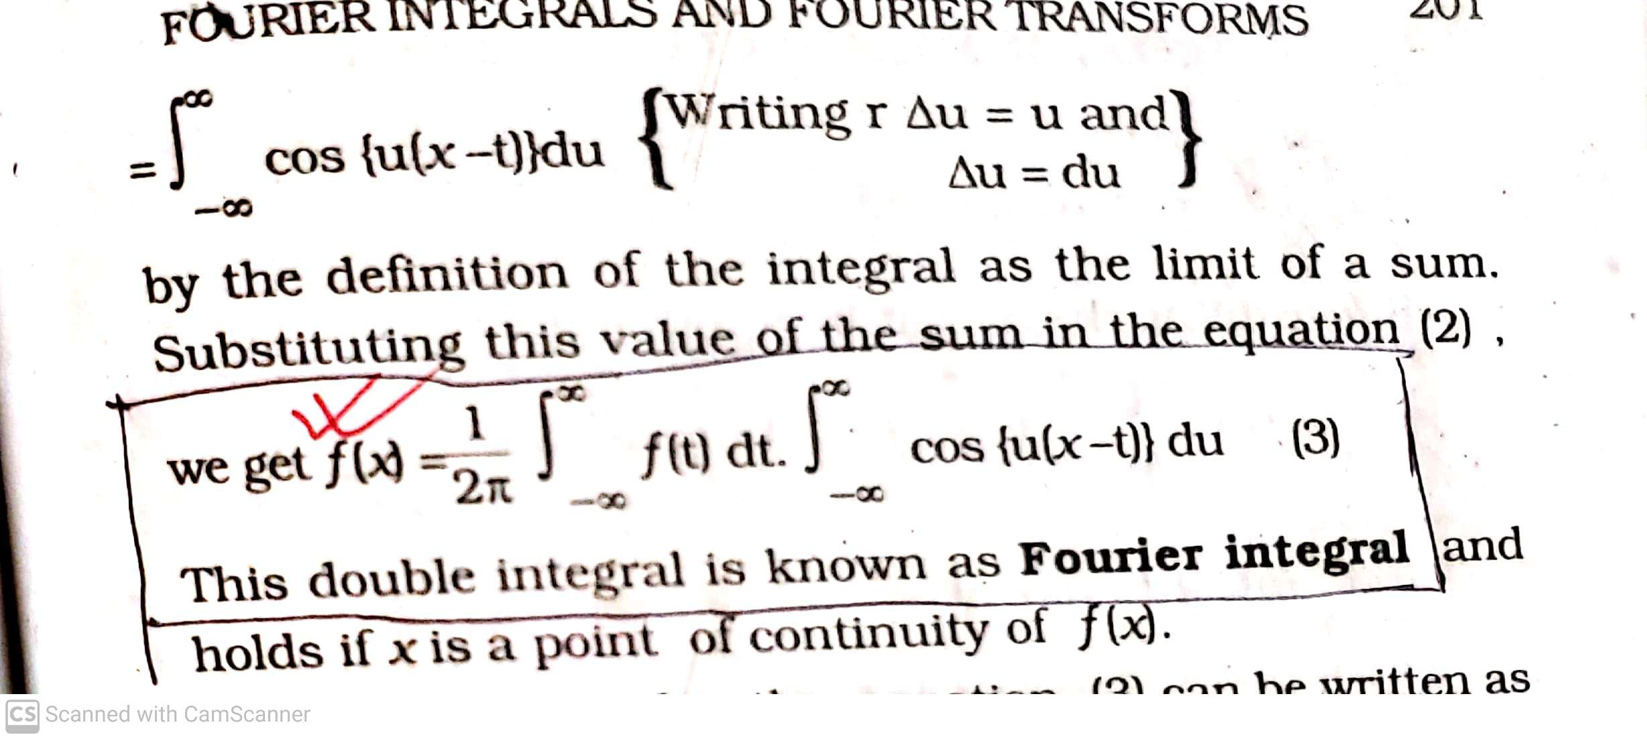
Fourier Integral

Slide 4
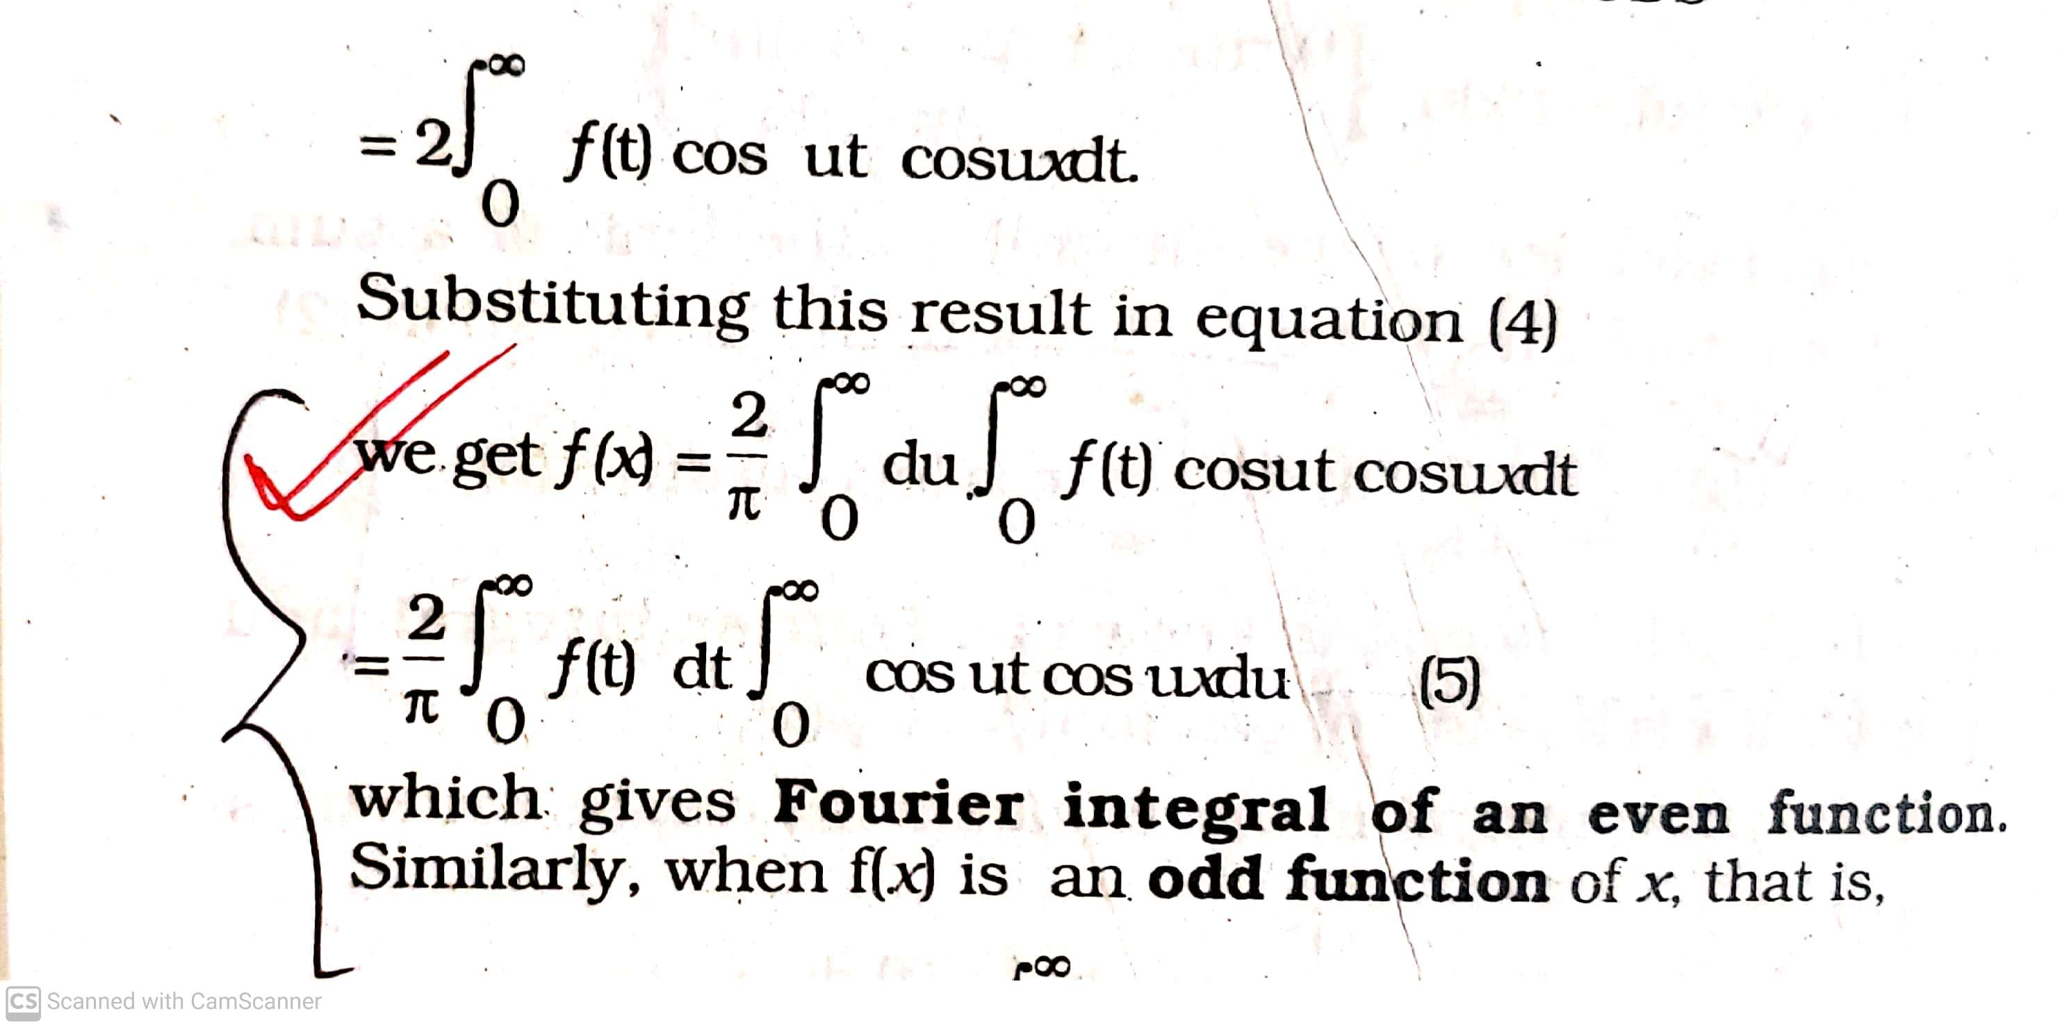

Slide 5
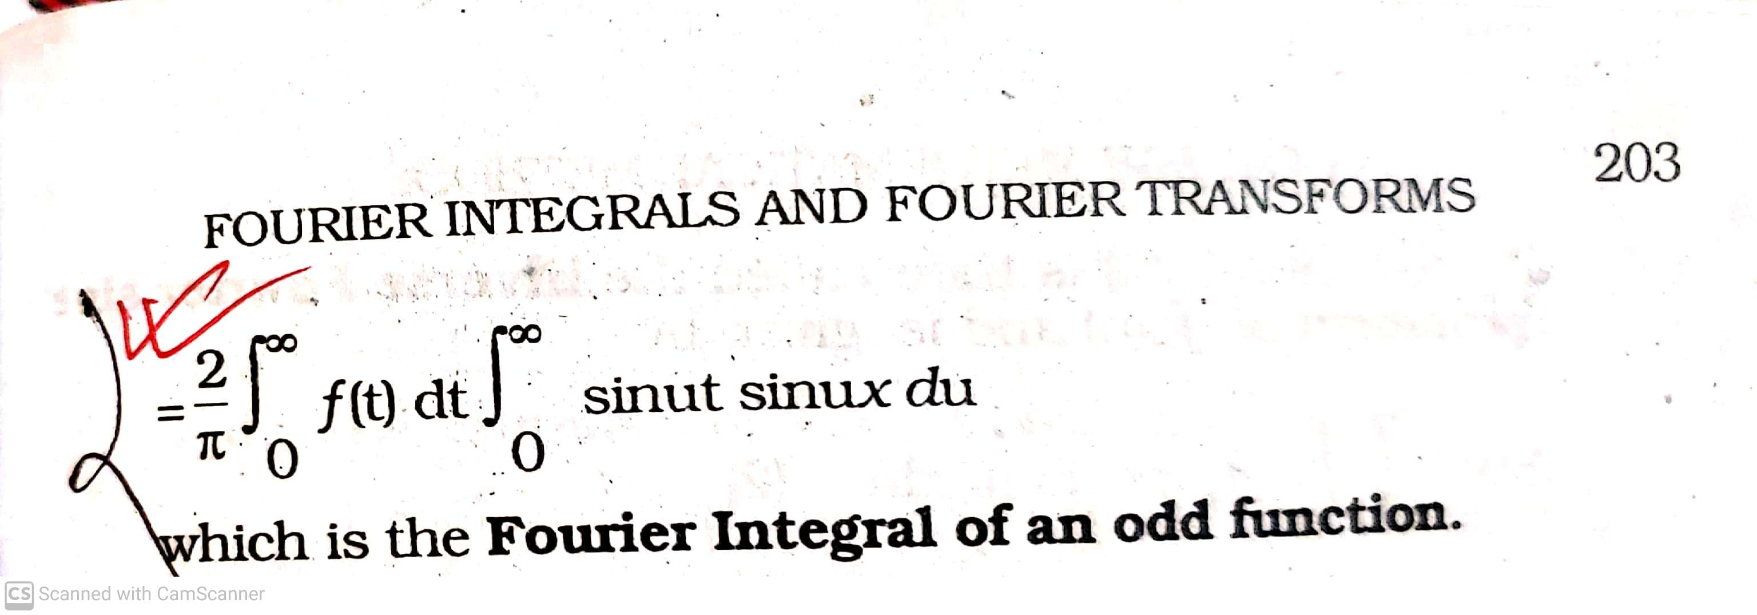

Slide 6
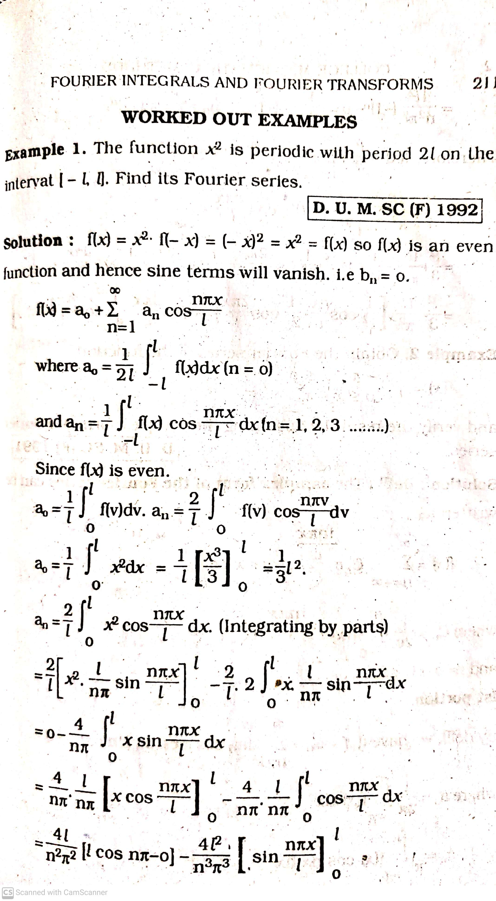

Slide 7
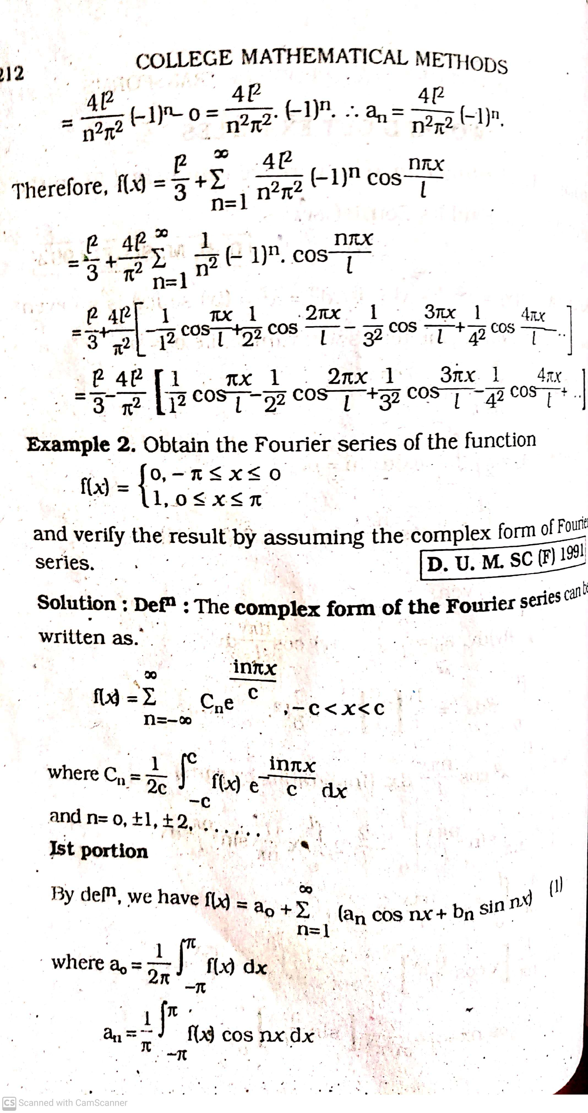

Slide 8
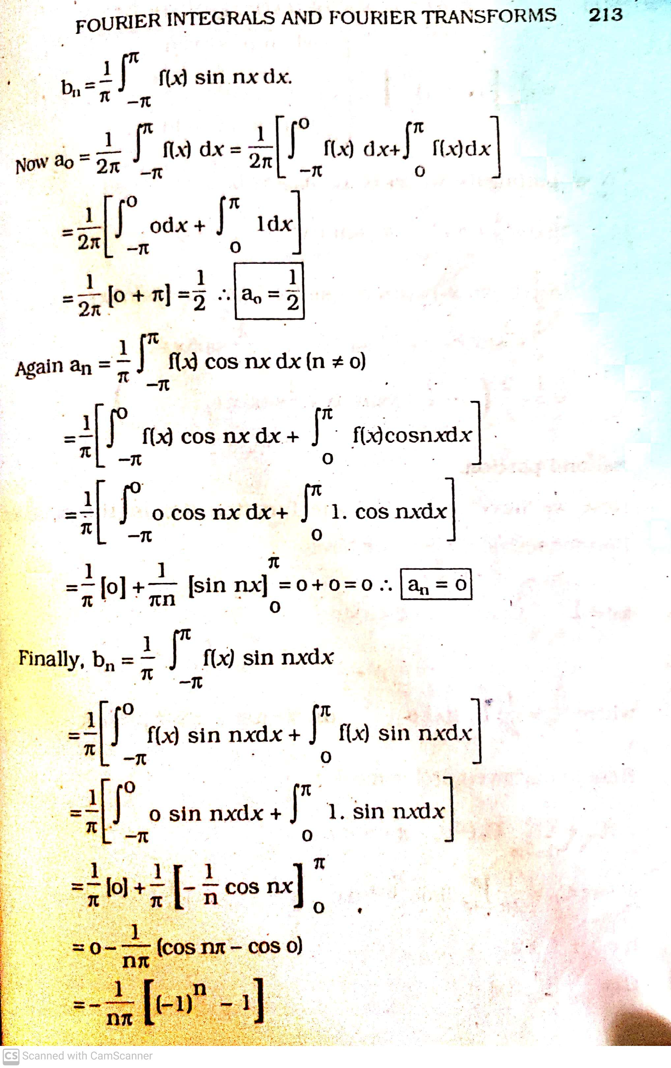

Slide 9
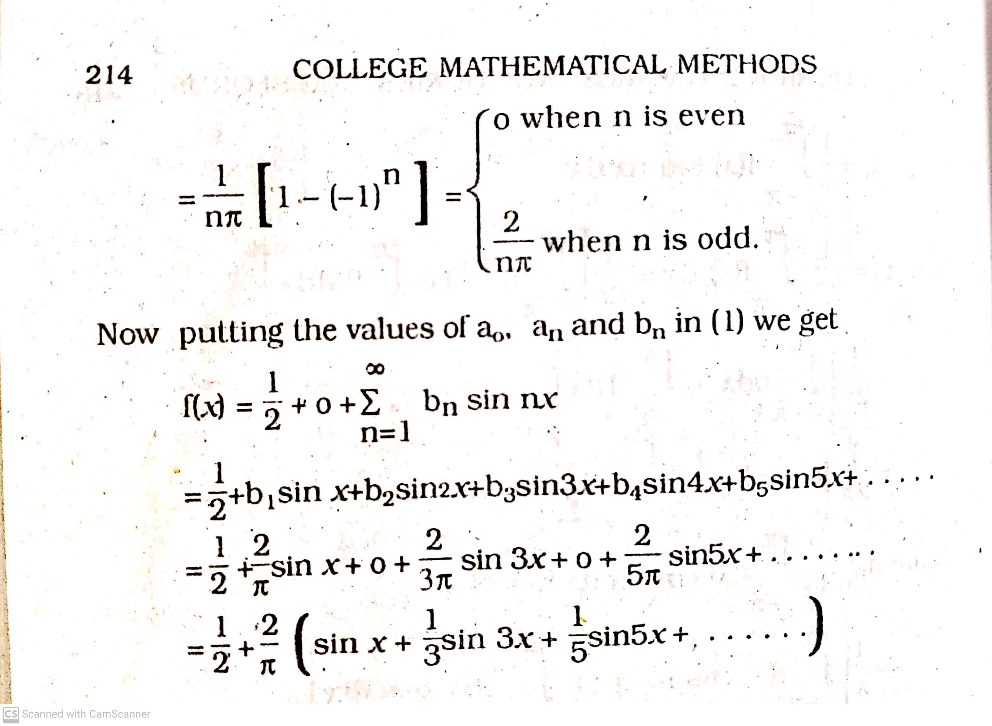

Slide 10
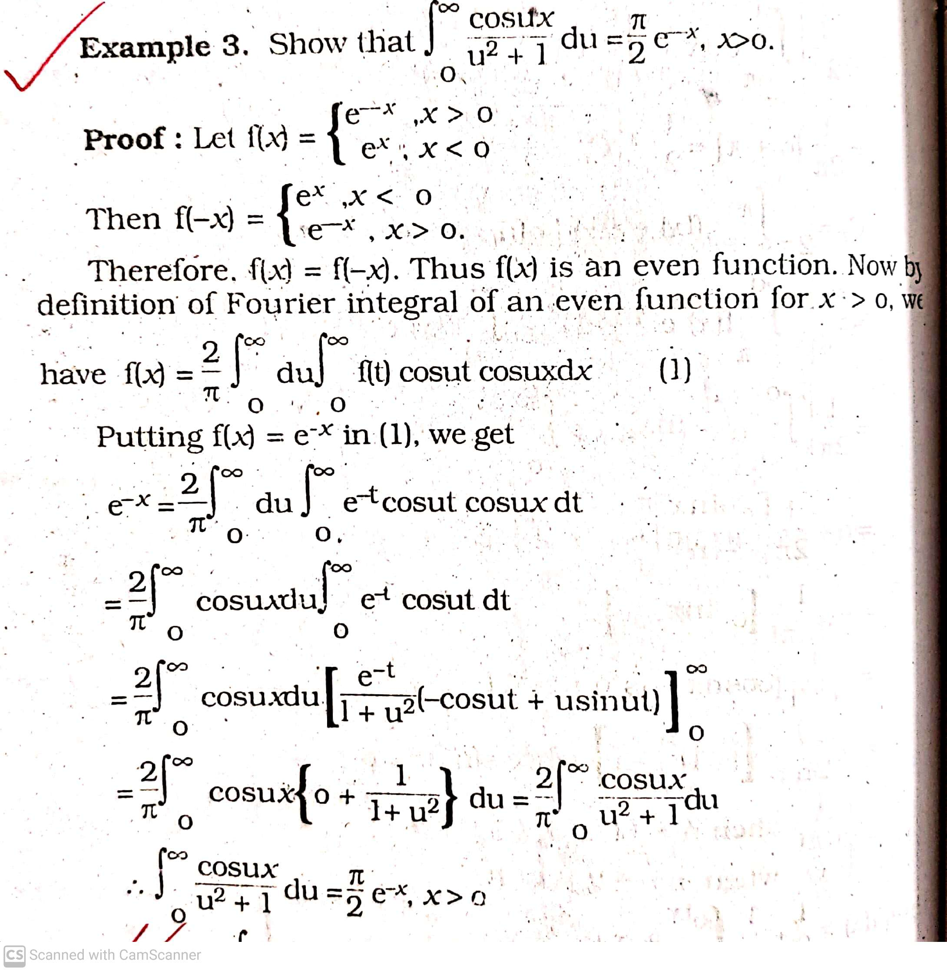
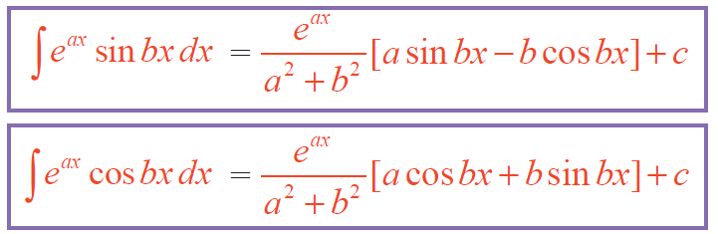

Slide 11
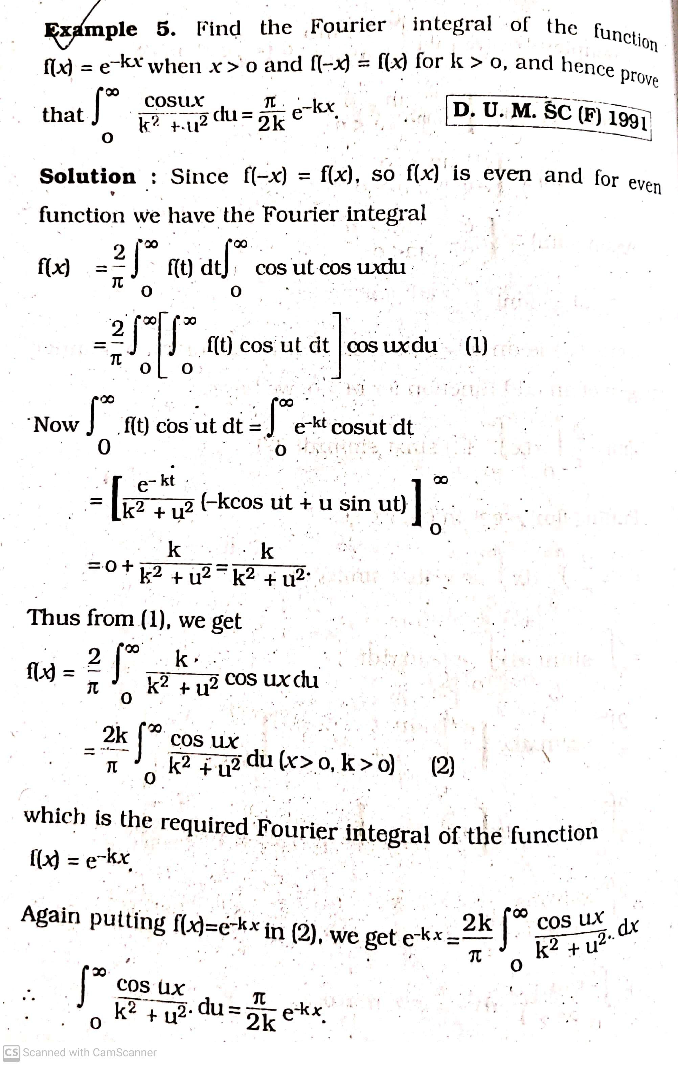

Slide 12
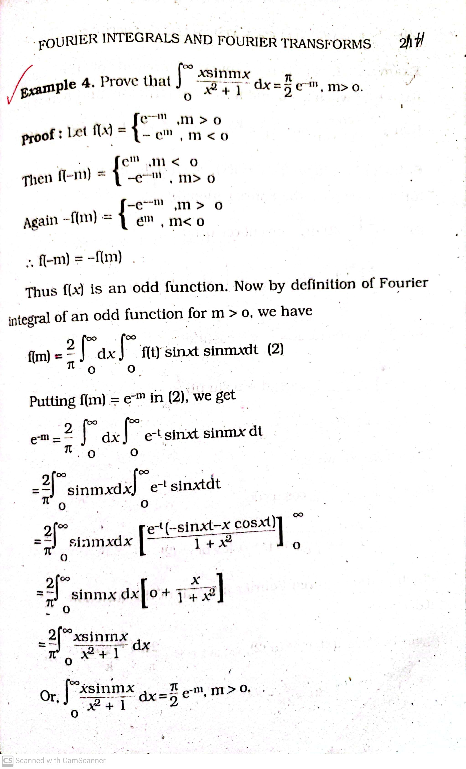

Slide 13
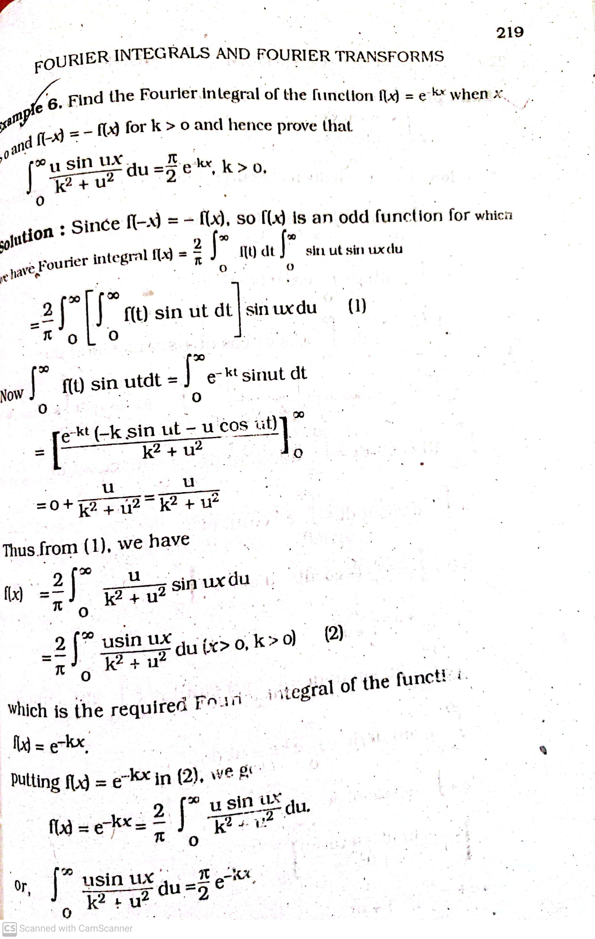

Slide 14
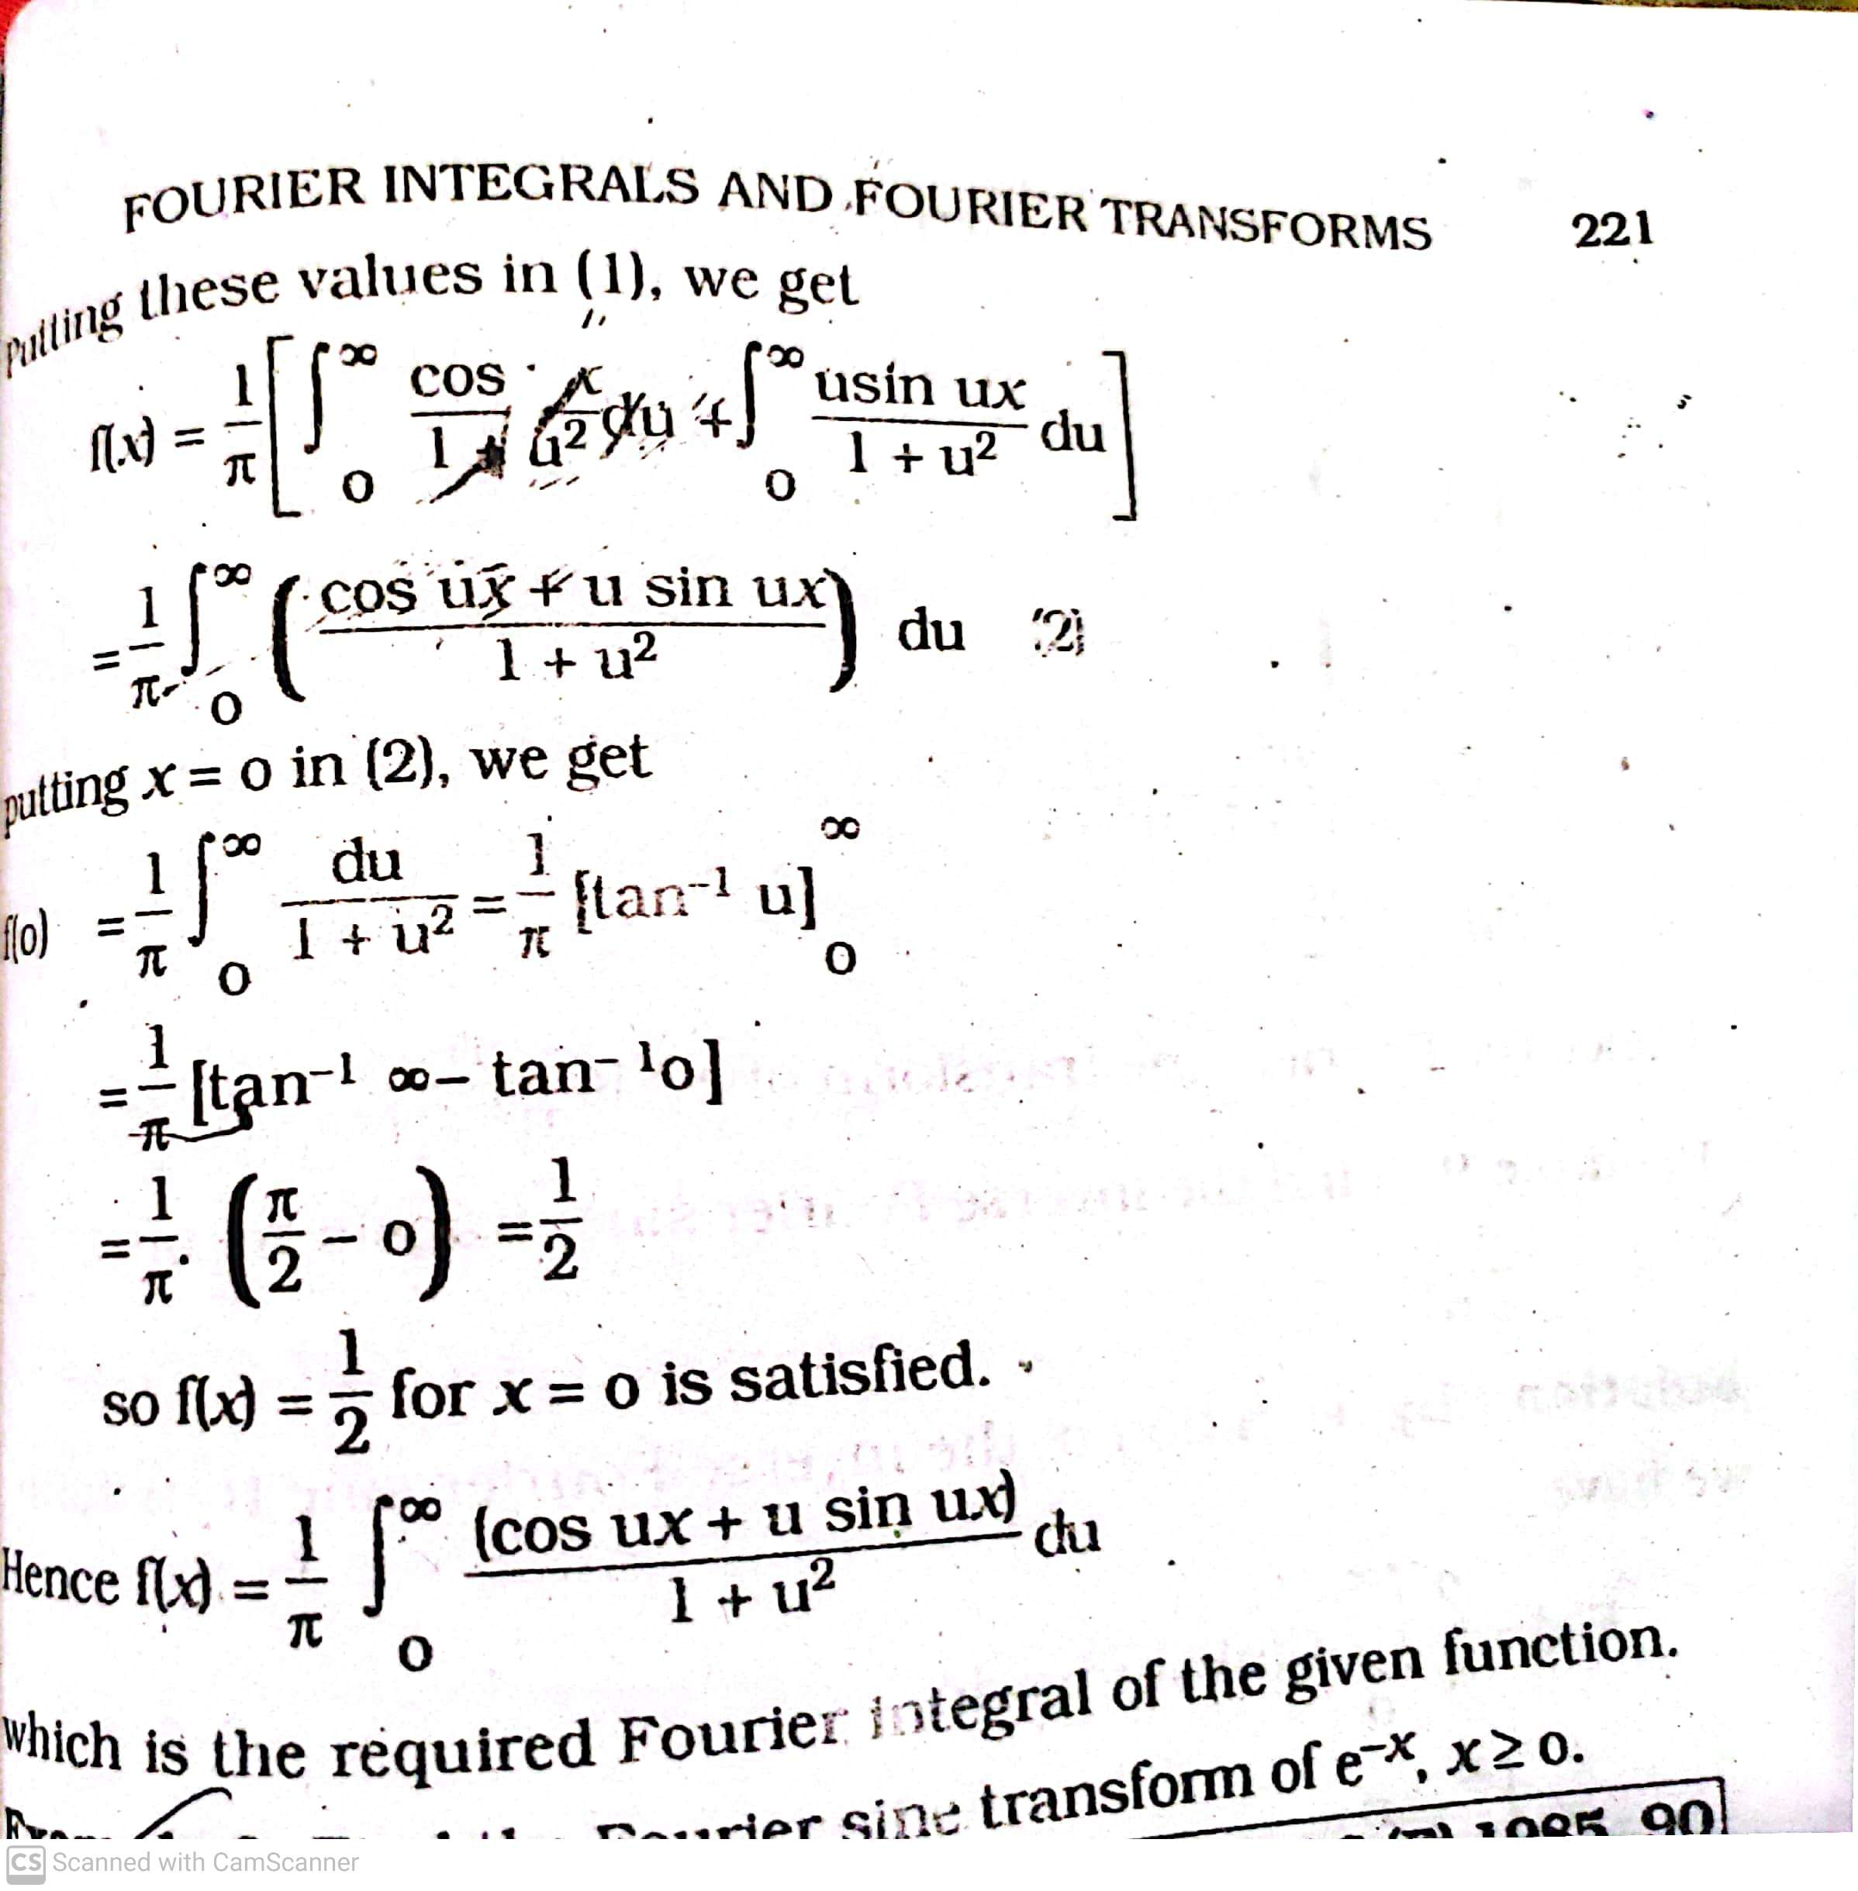
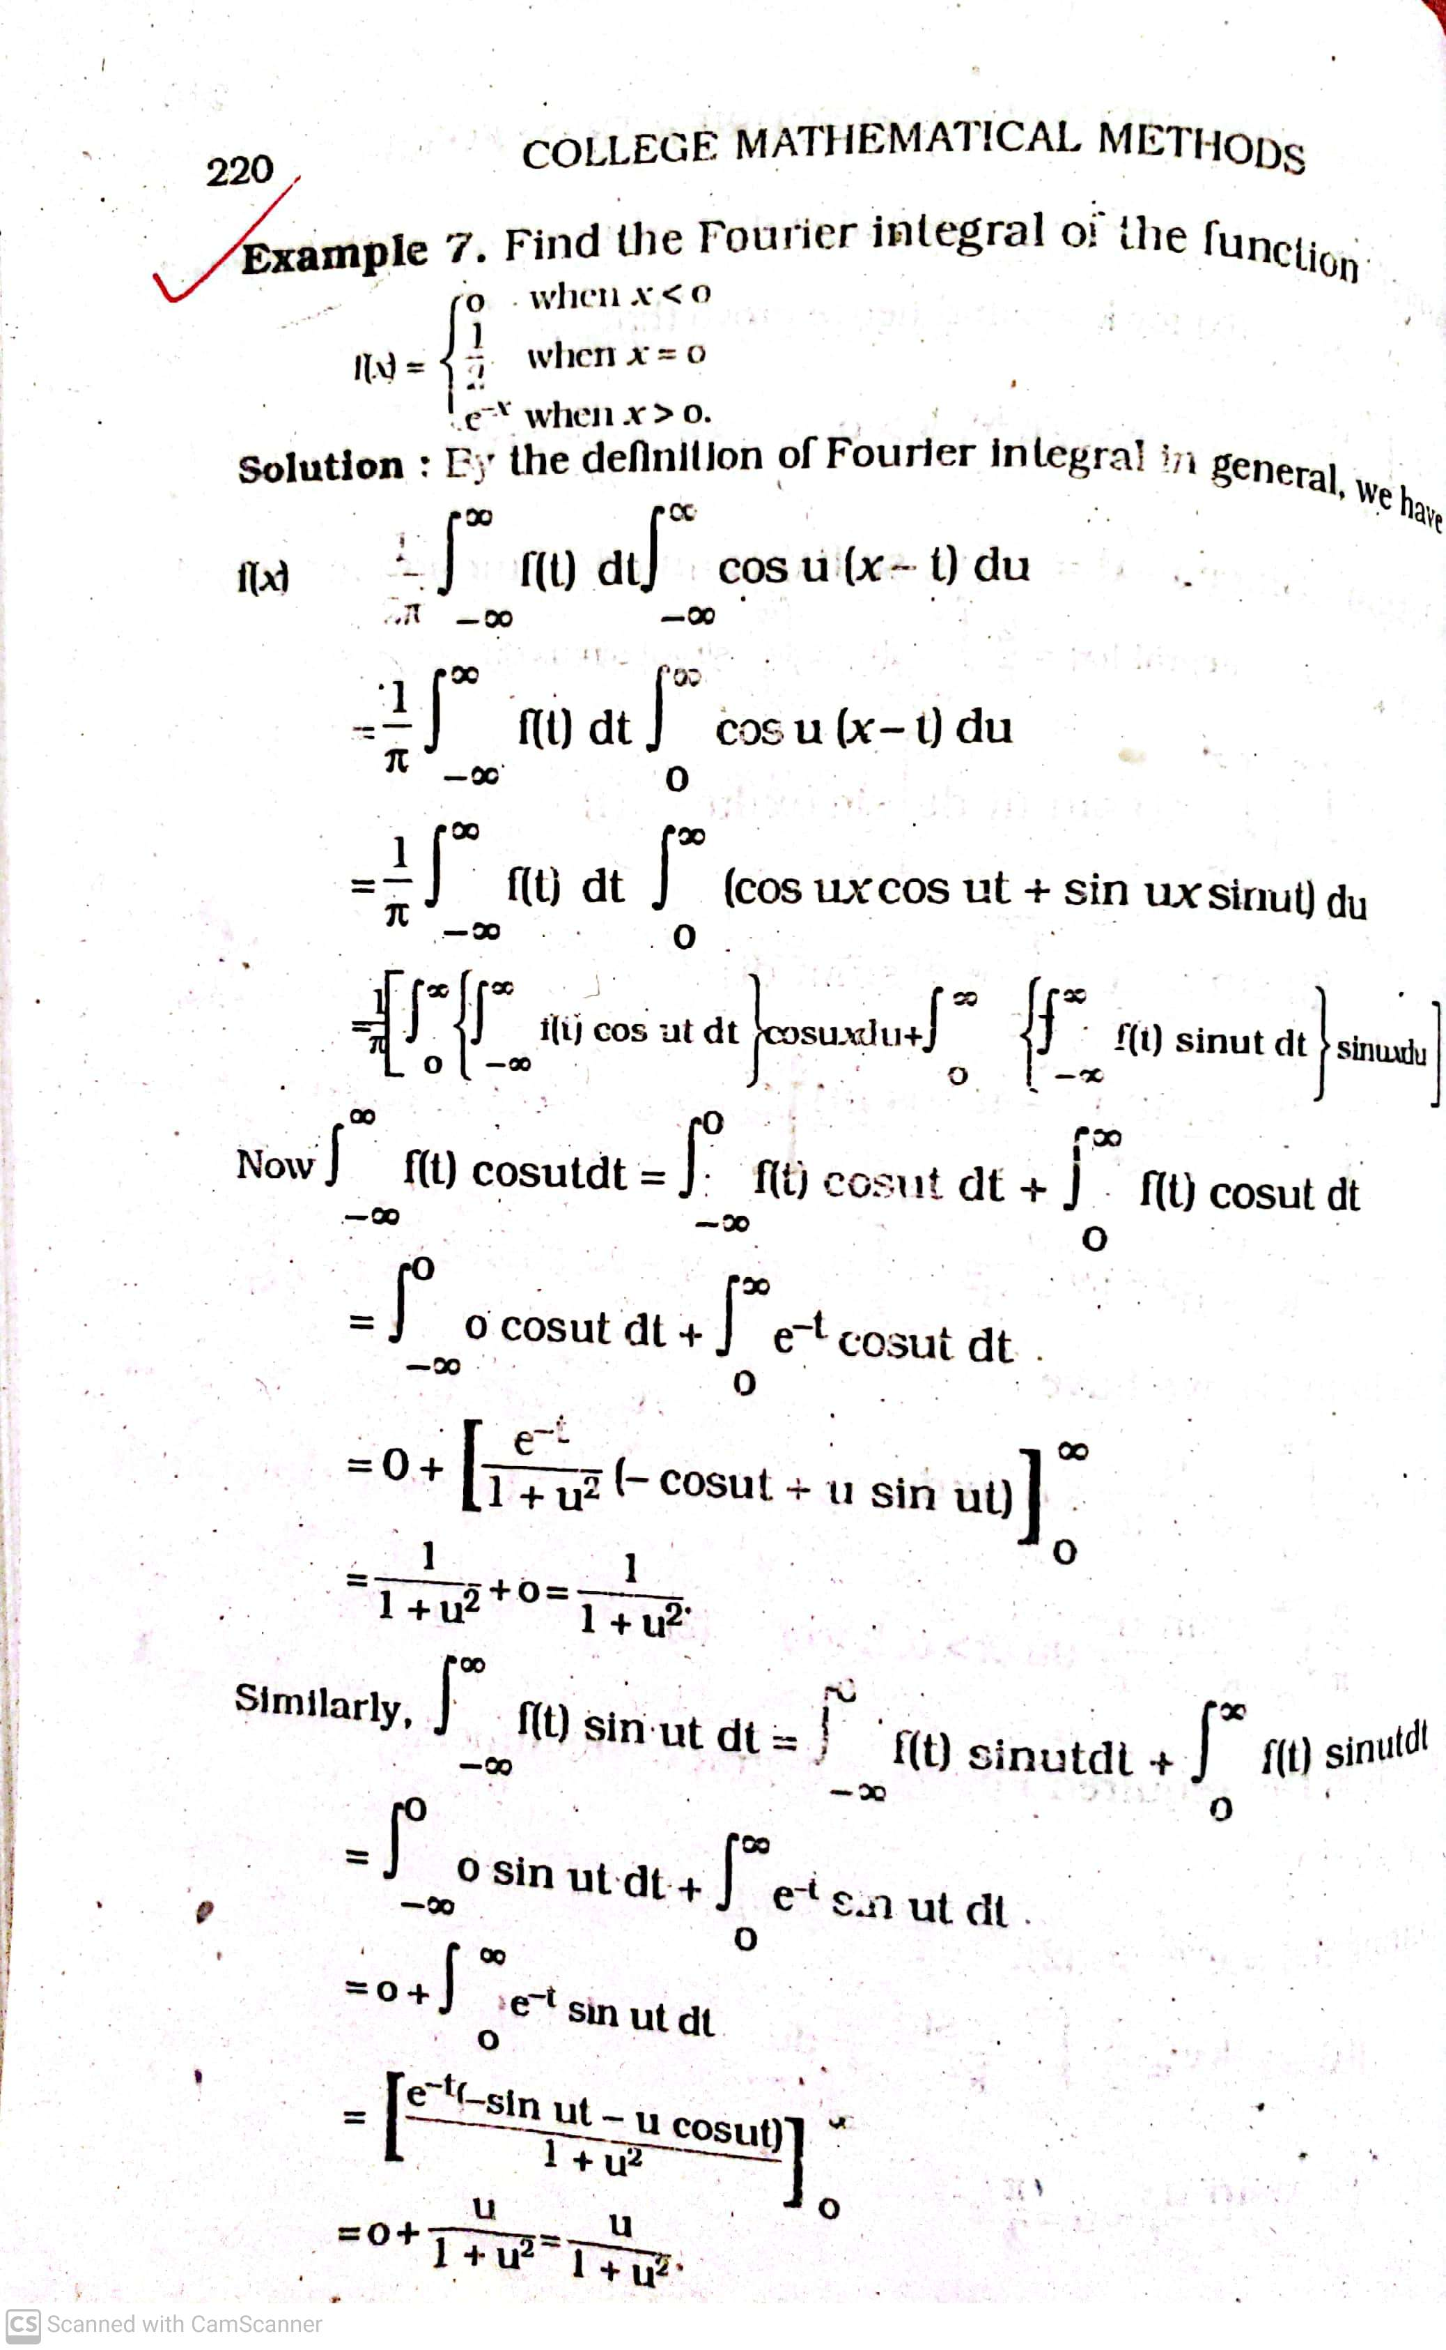

Slide 15
Thank you

